Slide 1

CLOUD COMPUTING IA - 2
GROUP NUMBER - 22
GROUP MEMBERS: YASH BHANUSHALI - 16010122020 SOHAM BHUTADA - 16010122024 KRISHNA CHANDAK - 16010122026
MENTOR : PROF.ZAHEED SHAIKH

Slide 2

The Rise of AI-Driven Automation in Cloud Resource Management
Artificial intelligence is revolutionizing cloud resource management by automating tasks, optimizing resource allocation, and improving overall efficiency, leading to significant cost savings and enhanced scalability.
The market for AI in cloud computing is rapidly expanding, with projections estimating a reach of $28.4 billion by 2027, highlighting the increasing adoption and impact of AI-driven solutions.
This presentation will delve into the transformative benefits of AI in cloud resource management, address key challenges and considerations, and explore emerging trends shaping the future of this dynamic field.

Slide 3
Understanding Cloud Resource Management
Cloud resource management encompasses the strategies and tools used to efficiently allocate, provision, and monitor cloud resources such as virtual machines, storage, and network bandwidth.
Traditional methods often rely on manual configuration and static rule-based systems, leading to operational overhead and delayed response times.
Traditional Limitations
Manual vs. Automated Scaling
Inefficiency: Over-provisioning to handle peak loads results in wasted resources during off-peak times.
Manual Scaling: Responding to a sudden traffic spike might take 30-60 minutes, involving manual adjustments by IT staff.
Scalability Issues: Manual scaling processes struggle to keep pace with rapidly changing demand.
AI-Driven Scaling: Automated scaling, powered by AI, can detect anomalies and scale resources in seconds, minimizing downtime and ensuring optimal performance.
High Operational Costs: Labor-intensive monitoring and adjustments increase operational expenses.

Slide 4

How AI is Automating Cloud Resource Management
AI and Machine Learning algorithms are revolutionizing cloud resource management by dynamically optimizing resource allocation and utilization. These algorithms analyze usage patterns, predict future needs, and automatically adjust resources to meet demand, ensuring optimal performance and cost-efficiency.
Predictive analytics forecast demand with remarkable accuracy, reducing over-provisioning by an average of 20%. By anticipating workload fluctuations, AI enables proactive scaling, preventing resource bottlenecks and minimizing wasted capacity during off-peak periods.
Automated Scaling
Self-Healing Infrastructure
Dynamically adjusts resources based on real-time needs, scaling up during peak loads and scaling down during off-peak times. This ensures applications always have the resources they need without incurring unnecessary costs.
Automatically detects and recovers from faults, minimizing downtime and ensuring high availability. AI-driven systems can identify anomalies, diagnose problems, and initiate corrective actions without manual intervention.
Resource Allocation
AI/ML optimizes resource allocation and utilization, intelligently distributing resources across different applications and services based on their priority and resource requirements. This results in improved performance and reduced resource contention.

Slide 5
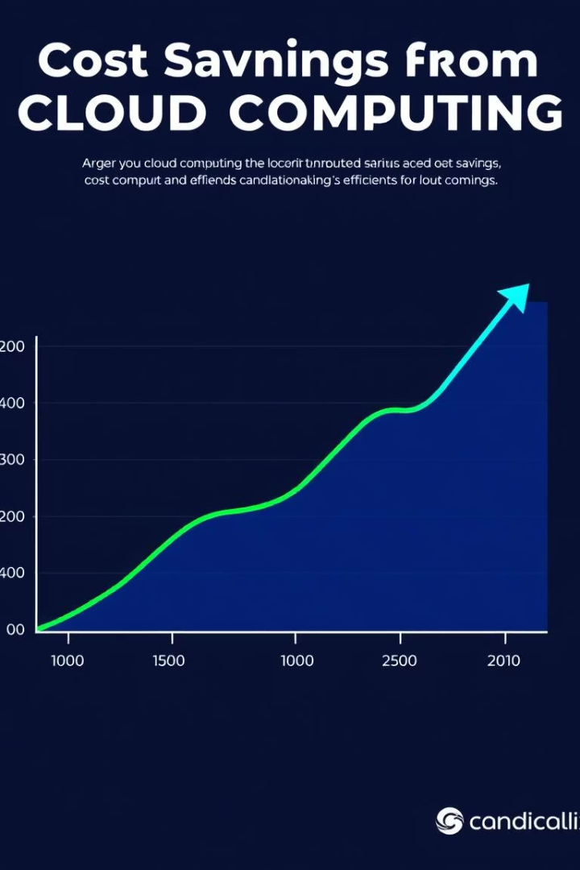
Key Benefits: Cost Reduction & Efficiency
AI identifies underutilized resources, leading to an average of 27% reduction in cloud spending by eliminating waste and optimizing usage.
Automated scaling reduces latency by up to 40%, improving application responsiveness and user satisfaction.
1
Cost Optimization
27% average reduction in cloud spending
2
Improved Performance
Up to 40% reduction in latency for critical applications
3
Increased Efficiency
Frees up IT staff by automating routine tasks, allowing them to focus on strategic initiatives

Slide 6
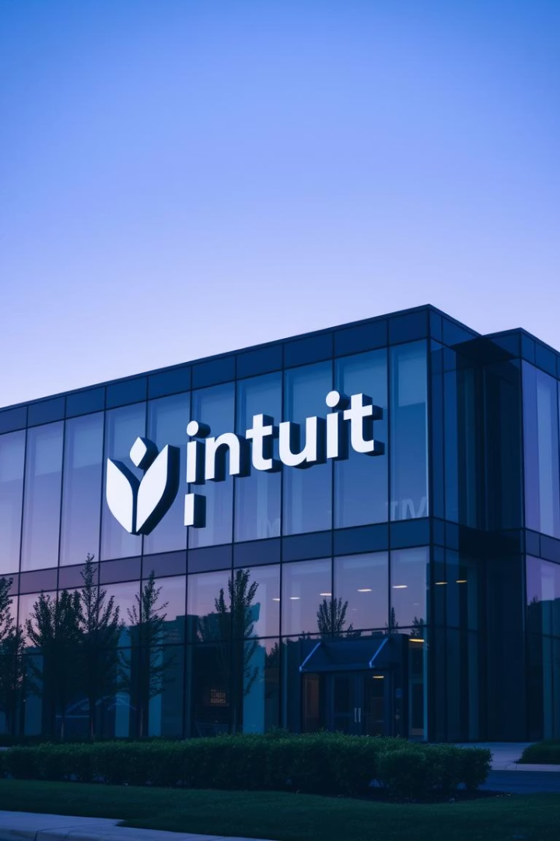



Case Study 1: AI-Driven Cost Optimization at Intuit
Intuit leveraged AI and machine learning to optimize its AWS infrastructure, resulting in significant annual cost savings. By implementing a comprehensive AI-driven cost management platform, Intuit was able to reduce its cloud spending while maintaining performance and reliability.
Analysis
AI algorithms analyzed historical AWS usage patterns across various services, identifying resource inefficiencies and anomalies.
Savings
Identified opportunities such as underutilized EC2 instances, optimal reserved instance purchasing, and automated rightsizing recommendations.
Results
Achieved a 20% reduction in overall cloud spending, equating to millions of dollars in annual savings, while improving application performance and resource utilization.

Slide 7
Case Study 2: Resource Optimization at Autodesk
Autodesk leverages machine learning to optimize resource allocation, resulting in significant performance gains and cost savings.
By implementing predictive scaling models, Autodesk ensures that applications have the necessary resources to meet demand, while avoiding over-provisioning and waste.
1
Predictive Forecasting
2
Proactive Resource Adjustment
3
Performance Improvement
Machine learning algorithms analyze historical usage patterns and predict future demand for resources, such as CPU, memory, and bandwidth.
Autodesk observed a 30% improvement in application performance and a 25% reduction in resource costs after implementing AI-driven resource optimization.
Based on the forecast, resources are automatically adjusted in advance to meet anticipated demand, ensuring optimal performance during peak periods.

Slide 8




Challenges and Considerations
Initial investment and integration costs can range from $50k to $500k.
There are data privacy and security concerns and risks of data breaches.
1
Skilled Personnel
2
Algorithmic Bias
3
Security Concerns
4
Integration Costs

Slide 9

The Future of AI in Cloud Management
The future of cloud management is increasingly intertwined with AI, promising a new era of efficiency, automation, and strategic decision-making. We anticipate significant advancements across several key areas:
Increased Adoption of AI-Driven Automation: Expect continued growth and adoption of AI-driven automation across various cloud services, leading to optimized resource allocation, predictive scaling, and proactive anomaly detection.
Focus on Explainable AI (XAI) for Transparency: As AI becomes more integrated, there will be a greater emphasis on explainable AI (XAI) to ensure transparency and trust in AI-driven decisions, allowing organizations to understand and validate AI recommendations.
Integration with Edge Computing: AI will play a crucial role in managing and optimizing resources in edge computing environments, enabling real-time data processing, reduced latency, and improved performance for edge-based applications.
Expansion into Hybrid Cloud Environments: AI-powered cloud management solutions will extend their capabilities to hybrid cloud environments, providing unified visibility, consistent policy enforcement, and automated workload placement across on-premises and public cloud infrastructure.

Slide 10

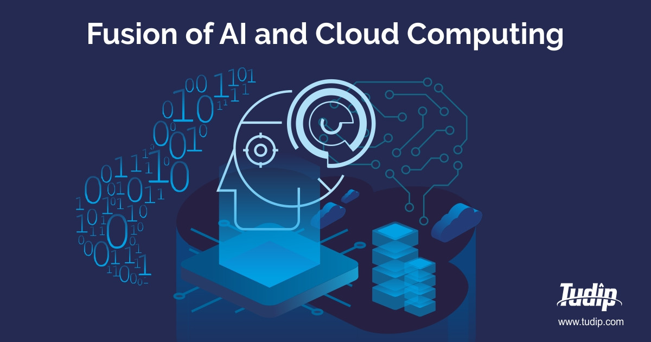
1
AI is the Future
2
Improved Efficiency
3
Strategic Decisions
AI-driven automation will continue to transform cloud resource management.
AI enables organizations to optimize resource allocation and reduce costs.
AI-powered solutions facilitate proactive decision-making and anomaly detection.

Slide 11
THANK YOU!

